Slide 1
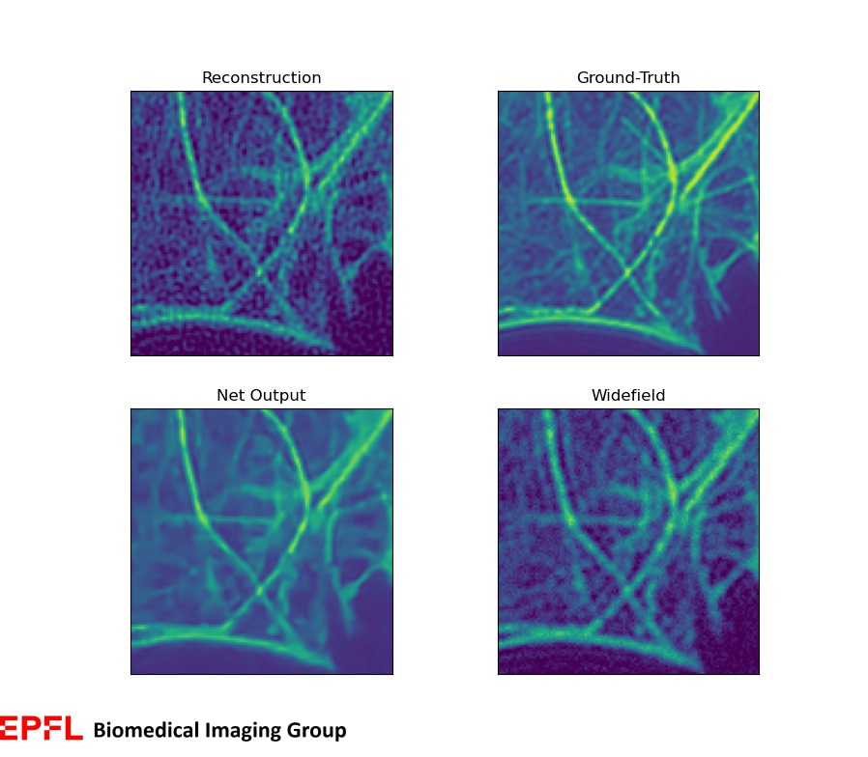
Deep neural network for SIM super-resolution reconstruction with a reduced number of images
by Kay Lächler
Supervisors: Daniel Sage & Emmanuel Soubies

Slide 2
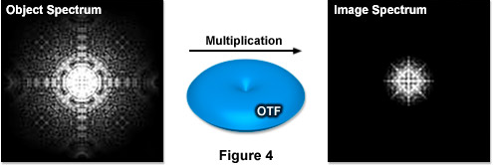
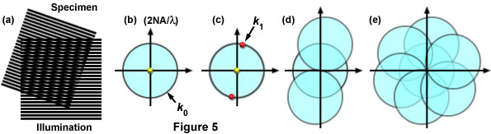
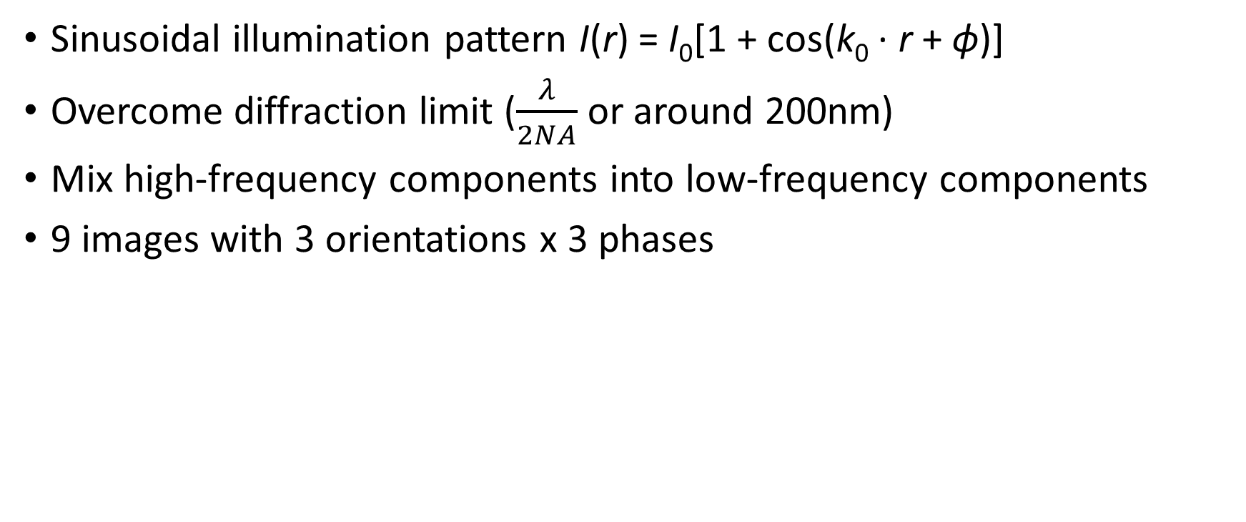
Super-Resolution Structured illumination microscopy (SR-SIM)
Sinusoidal illumination pattern I(r) = I₀[1 + cos(k₀ · r + ϕ)]
Overcome diffraction limit ($\frac{λ}{2NA}$ or around 200nm)
Mix high-frequency components into low-frequency components
9 images with 3 orientations x 3 phases
Source: http://zeiss-campus.magnet.fsu.edu/articles/superresolution/supersim.html
Notes:
Image acquisition = low-pass filter
Moiré fringes
Reciprocal space = Fourier Space
If line pattern close to diffraction limit -> double resolution achieved

Slide 3
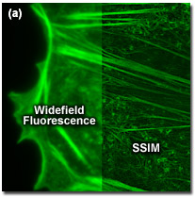
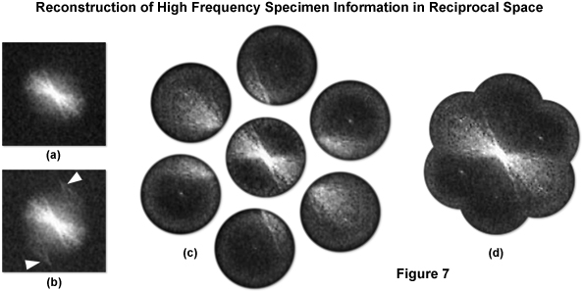
Direct method
Using linear algebra to un-mix the Fourier components and create the composite Fourier Transform [1][2]
Pros: Good results, Reliable
Cons: Slow acquisition (9 images)
Cons: Can create unwanted artefacts in presence of noise
[1] R. Heintzmann and C. G. Cremer, “Laterally modulated excitation microscopy: Improvement of resolution by using a diffraction grating,” Proc. SPIE, vol. 3568, pp. 185–196, Jan. 1999.
[2] M. G. L. Gustafsson, “Surpassing the lateral resolution limit by a factor of two using structured illumination microscopy,” J. Microscopy, vol. 198, no. 2, pp. 82–87, Dec. 2001.
Source: http://zeiss-campus.magnet.fsu.edu/articles/superresolution/supersim.html

Slide 4
Using DNNs for SR-SIM : State of the art
W2S [3]
Train a DNN to map a widefield (WF) image to a super-resolved SIM (SR-SIM) image
Pros: Fast acquisition (only one image, the WF)
Cons: unreliable as the input data (WF) do not contain high-frequency information
ML-SIM [4] or SR-REDSIM [5]
Train a DNN to reconstruct a SR-SIM from the raw data
Pros: physically relevant as the input data contains the high-frequecy info
Pros: can work with a reduced number of raw SIM images to accelerate acquisitions
Cons: Does not exploit the knowledge we have on how frequency components are mixed in SIM
RED-fairSIM [5]
Train a DNN to improve (artifact correction) the 9-images reconstruction obtained with FairSIM [6]
Pros: Exploits the knowledge we have on how frequency component are mixed in SIM
Pros: Significantly less sensitive to a change of system parameters between learning and testing
Cons: Slow acquisition (9 images)
[3] Majed El Helou, Daniel Sage, Thierry Laroche, Arne Seitz, Sabine Süsstrunk and W2Ruofan ZhouS, “Microscopy Data with Joint Denoising and Super-Resolution for Widefield to SIM Mapping”, ECCV 2020 Workshop on BioImage Computing, 2020
[4] Charles N. Christensen, Edward N. Ward, Pietro Lio and Clemens F. Kaminski, “ML-SIM: A deep neural network for reconstruction of structured illumination microscopy images”, University of Cambridge, 2020
[5] Zafran Hussain Shah , Marcel Müller , Tung-Cheng Wang , Philip Maurice Scheidig , Axel Schneider , Mark Schüttpelz , Thomas Huser , and Wolfram Schenck, “Deep-learning based denoising and reconstruction of super-resolution structured illumination microscopy images”
[6] Marcel Müller, Viola Mönkemöller, Simon Hennig, Wolfgang Hübner and Thomas Huser ,“Open-source image reconstruction of super-resolution structured illumination microscopy data in ImageJ”, Nature Communications, 2016

Slide 5
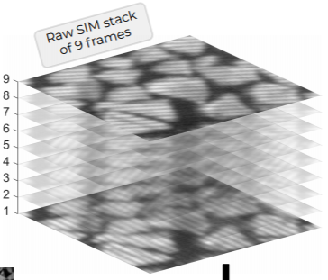
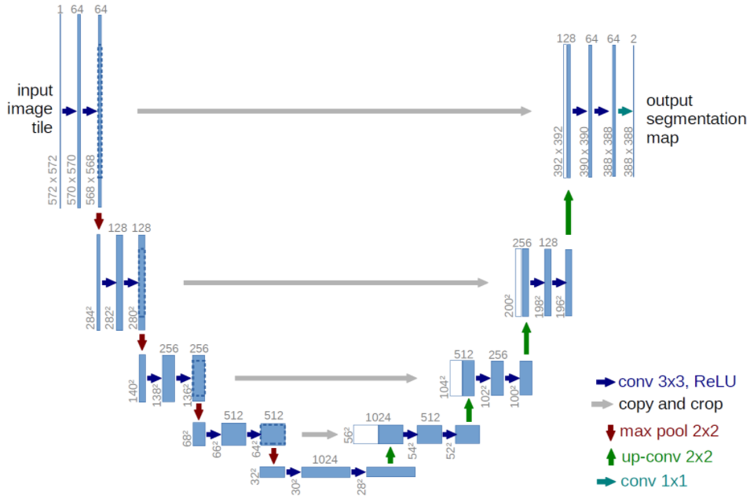
Could we get the best of both 2. and 3.? → This Project
Exploit redundancy in 9-image SR-SIM
Direct method using 4 images (3 orientations + Widefield)
It can be shown that 4 images (3 orr + 1 WF) contain all the frequency information needed for SR-SIM reconstruction
A direct reconstruction algorithm can be derived [See Semester project of Christophe Mueller, Fall 2018]
Imperfect 4-image SR-SIM creates a lot of artefacts
Correct artefacts with DNN
Raw SIM stack of 3 frames + Widefield
4-image SR-SIM reconstruction
DNN
Super-Resolution image

Slide 6
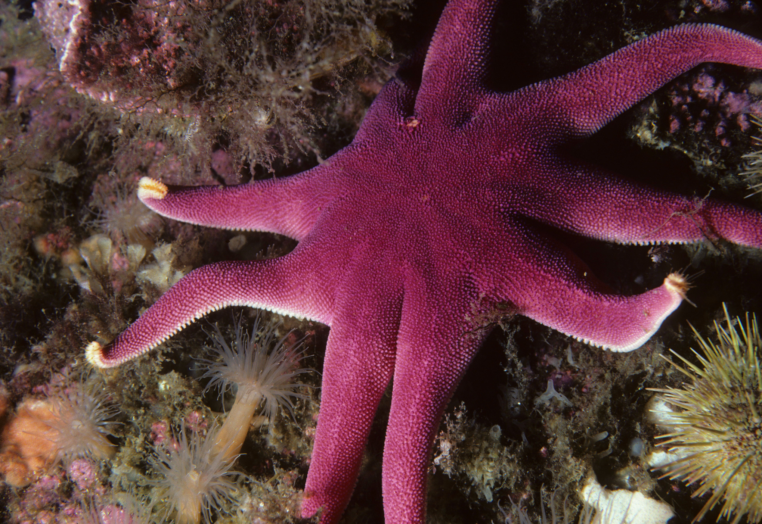
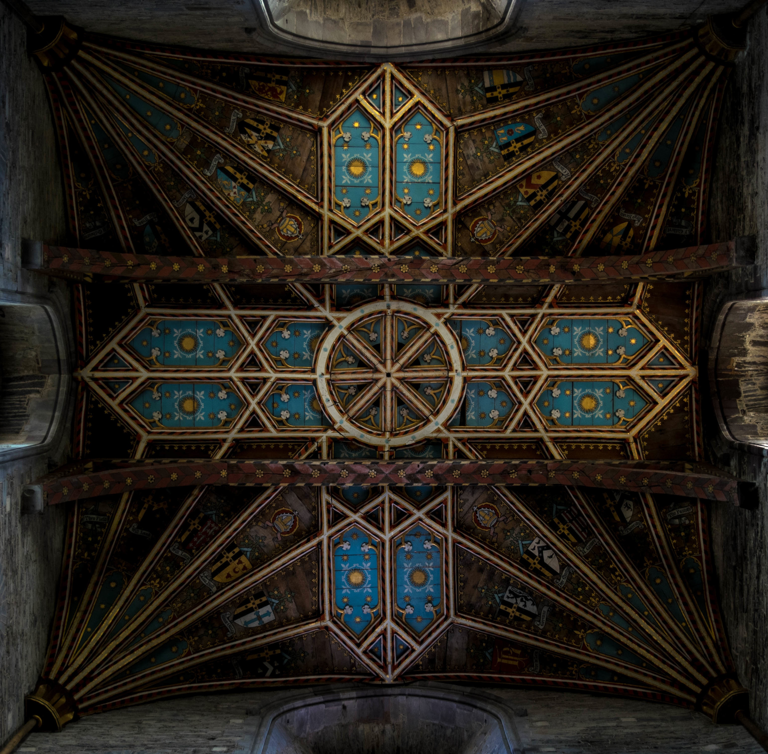
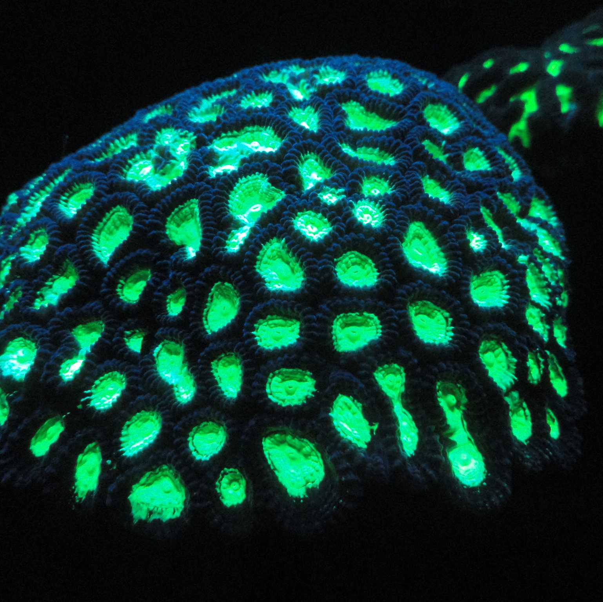
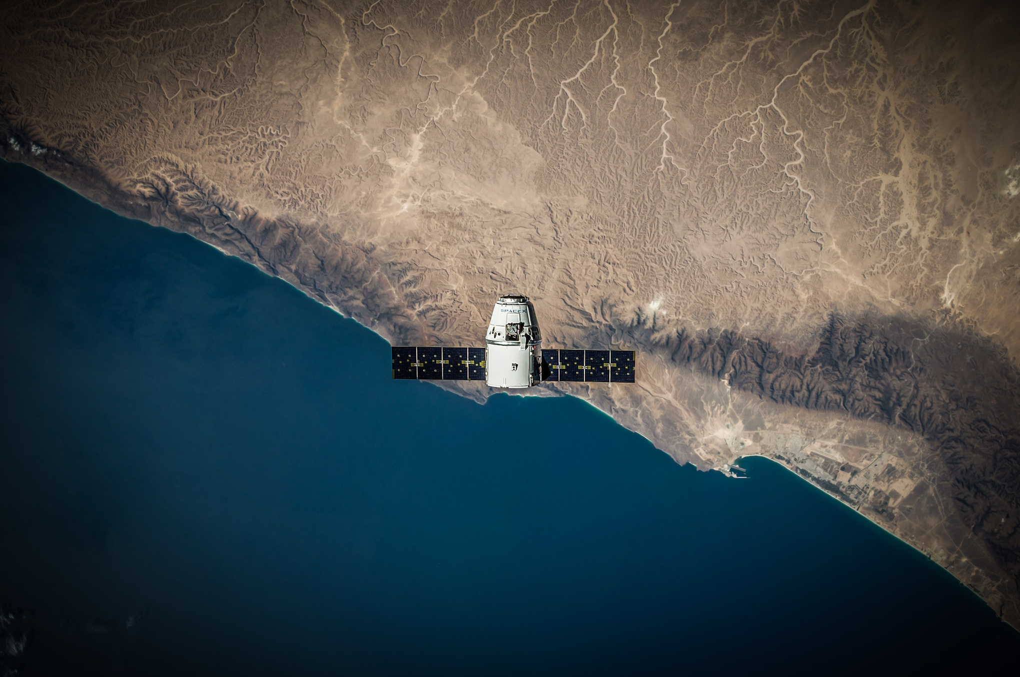
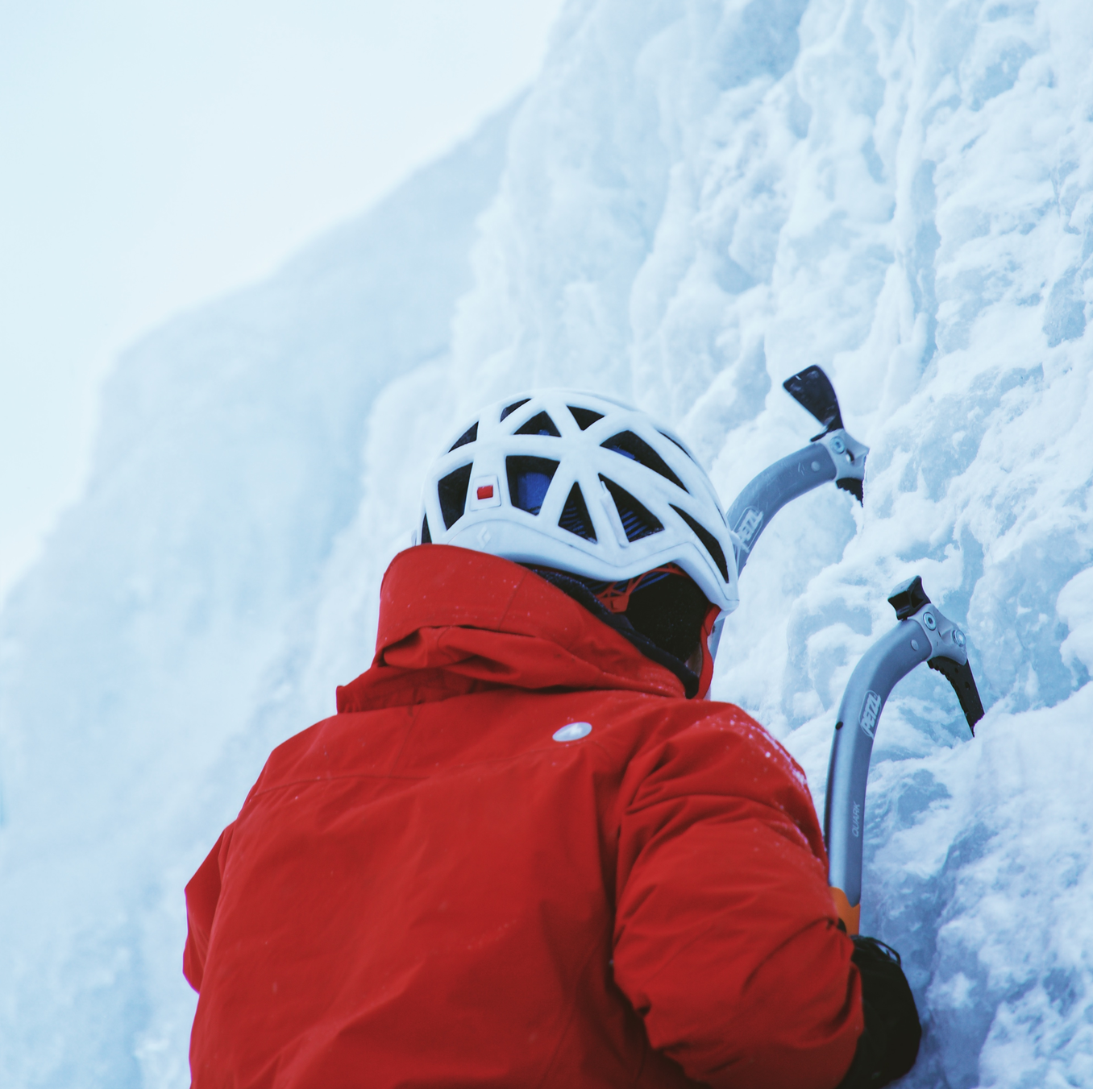
DNN Structure / Training
“U-Net” structure
Convolutional Neural Net with several skip connections
Very memory-intensive (because of skip connections)
Using a combination of L1 and SSIM loss
At the moment using DIV2K dataset for training
900 diverse non-microscopy images
Input images are of size (1024x1024) and converted to
grayscale, mean=0, std=1
For a fair comparison all images are mapped to the range [0,1]

Slide 7
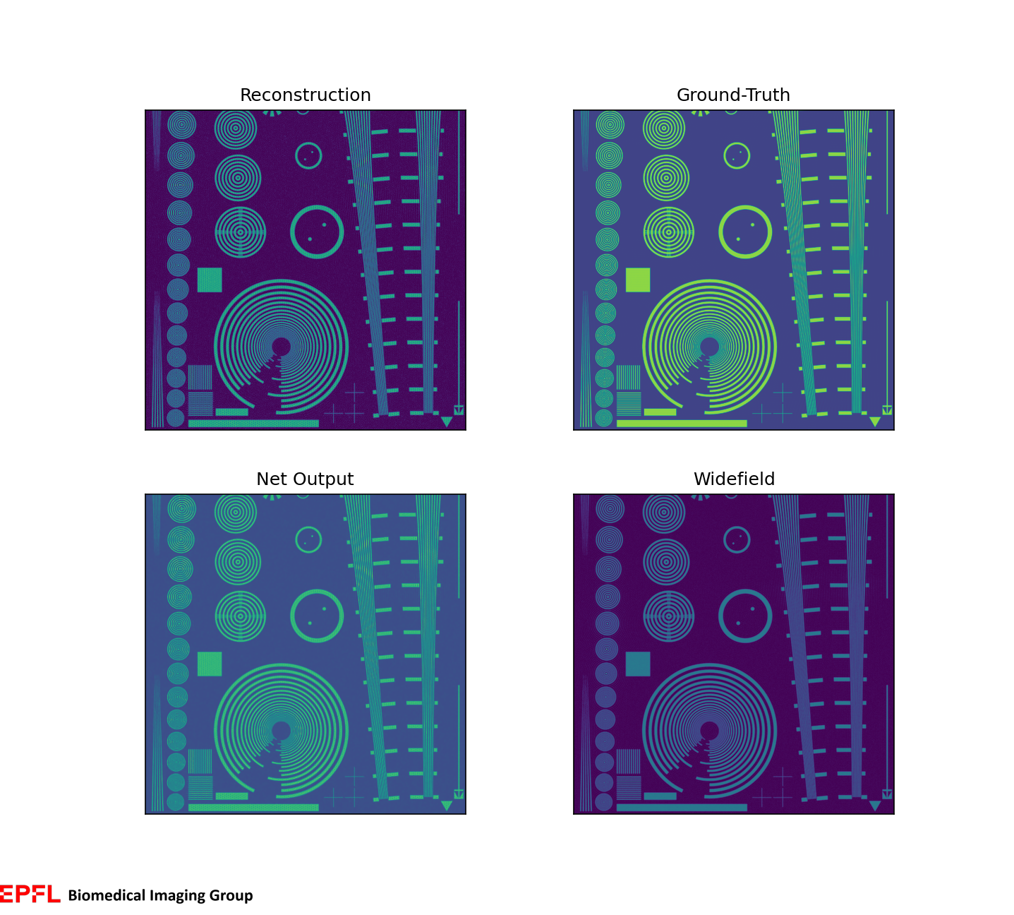
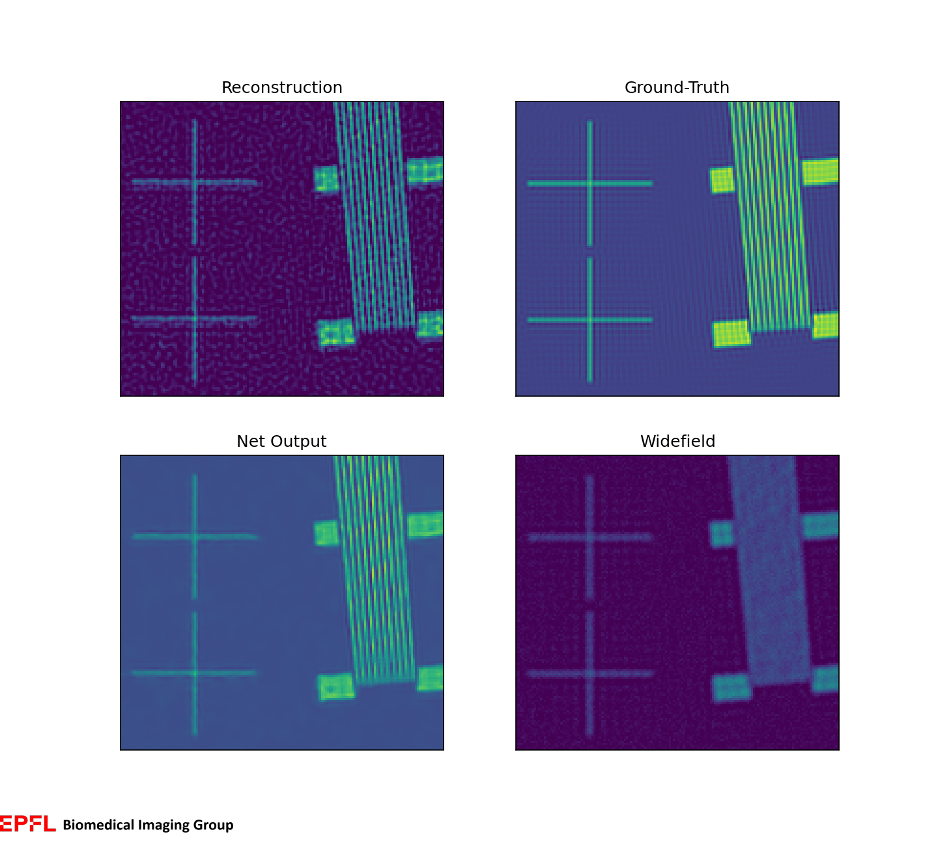
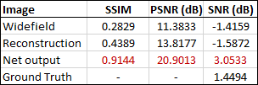
Intermediate Results: Generic Test Image

Slide 8
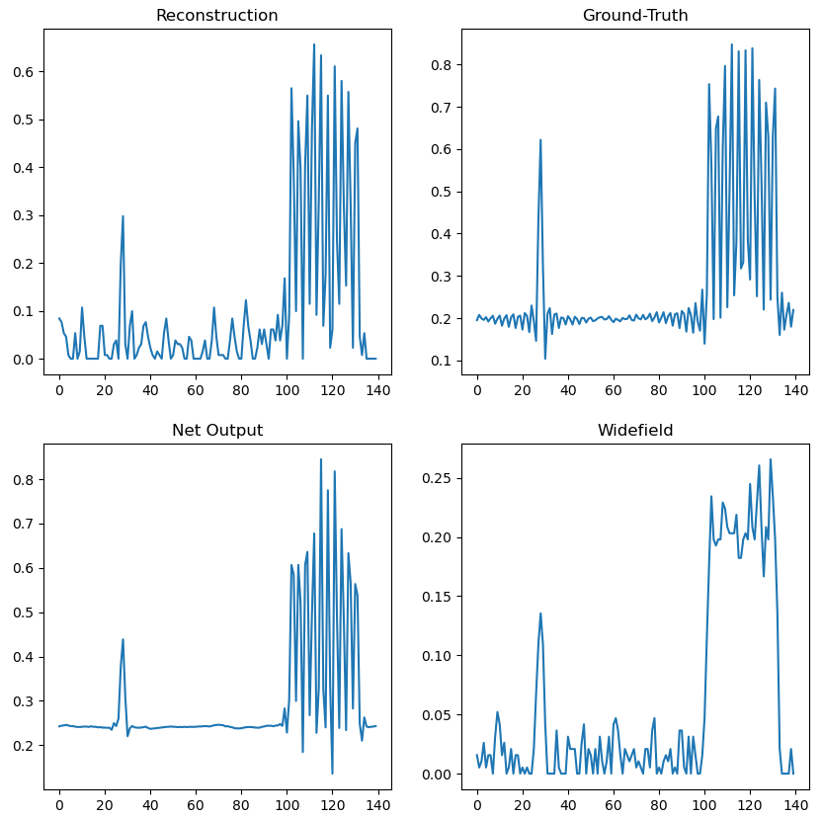

Slide 9
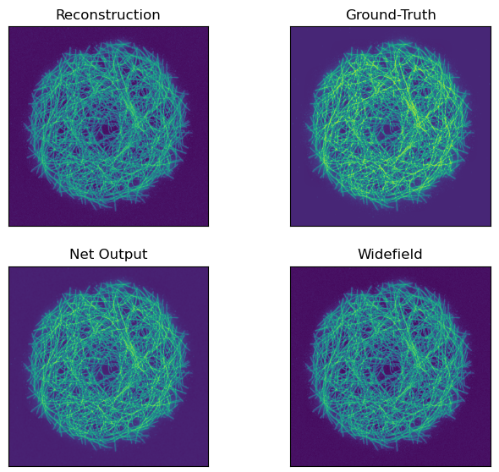
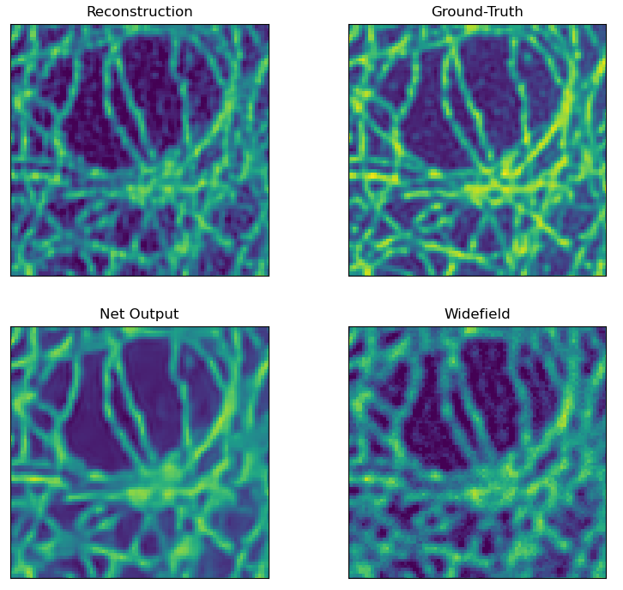
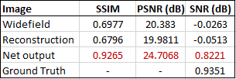
Intermediate Results: Microscopy Test Image

Slide 10
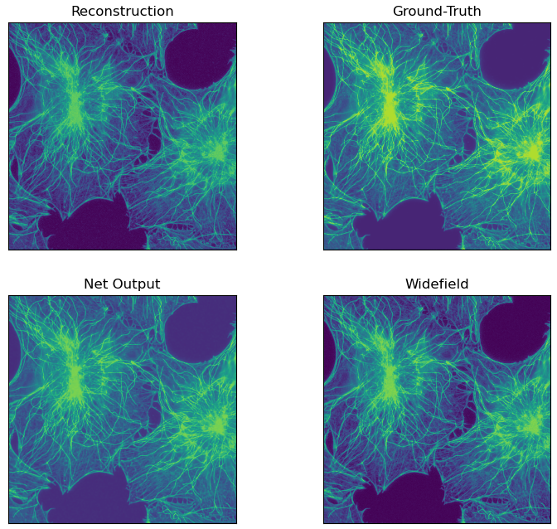
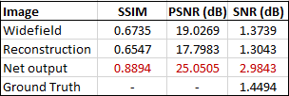
Intermediate Results: Microscopy Test Image

Slide 11
What’s next?
Experiment with different noise levels (here SNR=20dB)
Experiment with variations of loss function (weights for L1 and SSIM, here 0.16 and 0.84)
Try RCAN network
Not as memory intensive
Could use Laplacian loss function that encourages high freq. correctness
Train on microscopy images → dataset used by W2S (SIM would still be simulated)
4-image simulated SIM: use real PSF/OTF
Train on real SIM data → no suitable dataset found

Slide 12

Discussion Time

